Slide 1
Architecture of a Modern Microcontroller
Course Teacher: Protik Parvez Sheikh

Slide 2
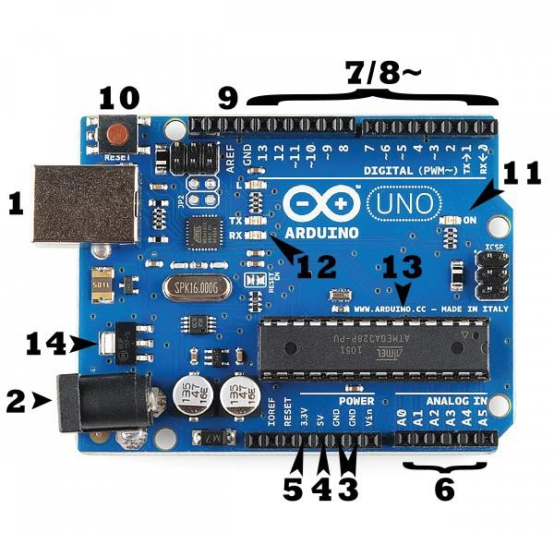
Basics Features of Arduino UNO
Consists of both a programmable microcontroller (ATMega328) and a piece of
software, or IDE
It uses a computer to write and upload code (written in the easier version of C++) to the microcontroller board and doesn’t need programmer/burner.
Operating voltage- 5Volt (7-12 Volt is recommended).
Digital pin- 14 (of which 6 provides PWM output).
DC Current per I/O pin= 20mA
DC Current 3.3V pin= 50mA

Slide 3
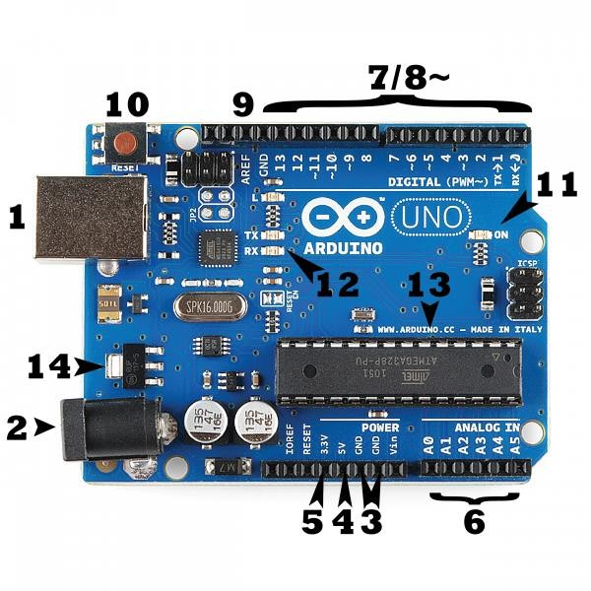
Arduino UNO Pin Configuration
1. Power (USB/Barrel Jack)
Every Arduino board needs a power source through a USB cable coming from your computer (1) or a wall power supply that is terminated in a barrel jack (2).
Pins (5V, 3.3V, GND, Analog, Digital, PWM, AREF):
GND (3): Short for ‘Ground’ and 5V (4) & 3.3V (5): used as supplies 5 volts of power, and the 3.3V pin supplies 3.3 volts of power.
Analog (6): The area of pins under the ‘Analog In’ label (A0 through A5 on the UNO) are Analog Input pins. These pins can read the signal from an analog sensor (like a temperature sensor) and convert it into a digital value that we can read.
Digital (7): Across from the analog pins are the digital pins (0 through 13 on the UNO).
PWM (8): You may have noticed the tilde (~) next to some of the digital pins (3, 5, 6, 9, 10, and 11 on the UNO). These pins act as Pulse-
Width Modulation (PWM, think of these pins as being able to simulate analog output (like fading an LED in and out).
AREF (9): Most of the time you can leave this pin alone.

Slide 4
Arduino UNO Pin Configuration
Reset Button:
Pushing it will temporarily connect the reset pin to ground and restart any code that is loaded on the Arduino.
Power LED indicator (11) : If this light doesn’t turn on, there’s a good chance something is wrong. Time to re-check your circuit.
TX RX LEDs(12) : These LEDs will give us some nice visual indications whenever our Arduino is receiving or transmitting data (like when we’re loading a new program onto the board).
Main IC (Integrated Circuit) (13) : The main IC on the Arduino is the ATmega328 microcontroller of the ATMEL company., where we
have to upload the code.
Voltage Regulator:
The voltage regulator (14) is used to control the amount of voltage that is let into the Arduino board. But don’t hook up your Arduino to anything greater than 20 volts.

Slide 5
Example of a Modern Microcontroller : ATmega328
ATmega-328 is basically an Advanced Virtual RISC (AVR) micro-controller. ATmega-328 has 32KB internal built in memory.
ATmega328 supports the data up to eight (8) bits and have 28 Pins. AVR Microcontroller, manufactured by Microchip, follows RISC Architecture and has a flash type program memory of 32KB.
ATmega328 has 1KB Electrically Erasable Programmable Read Only Memory (EEPROM). For a EEPROM, if the electric supply is removed from the micro-controller it can store the data. After providing electric supply it can provide previous results.
ATmega328 has 2KB Static Random Access Memory (SRAM).
It has 8 Pin for ADC operations, which all combines to form Port A ( PA0 – PA7 ).

Slide 6
It also has 3 built in Timers, two of them are 8 Bit timers while the third one is 16-Bit Timer.
Arduino UNO is based on Atmega328 Microcontroller. It is UNO’s heart.
It operates ranging from 3.3V to 5.5V but normally we use 5V as a standard.
Its excellent features include the cost efficiency, low power dissipation, programming lock for security purposes, real timer counter with separate oscillator.
It is normally used in Embedded System applications.
Moreover, ATmega328 has several different features which makes it the most popular device in today’s market. These features consist of advanced RISC architecture, good performance, 6 PWM pins, programmable Serial USART, programming lock for software security, throughput up to 20 MIPS etc.

Slide 7
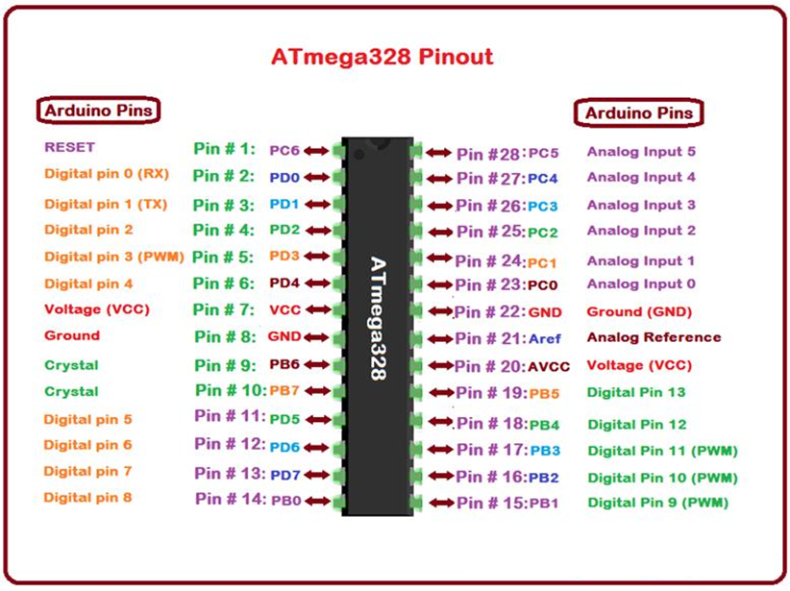

Slide 8
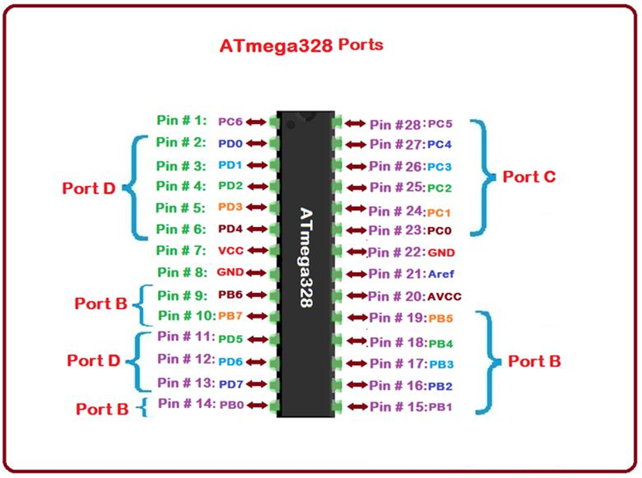

Slide 9
ATmega328 Pins Description
Functions associated with the pins must be known in order to use the device appropriately:
VCC is a digital voltage supply.
AVCC is a supply voltage pin for analog to digital converter.
GND denotes Ground and it has a 0V.
ATmega-328 pins are divided into different ports which are given in detail below:
Port B consists of the pins from PB0 to PB7. This port is an 8 bit bidirectional port having an internal pull-up resistor.
Port C consists of the pins from PC0 to PC7. The output buffers of port C has symmetrical drive characteristics with source capability as well high sink.
Port D consists of the pins from PD0 to PD7. It is also an 8 bit input/output port having an internal pull-up resistor.
AREF is an analog reference pin for analog to digital converter.

Slide 10
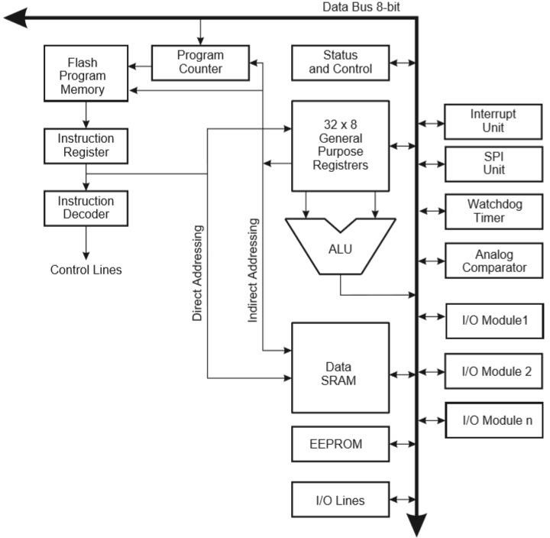
Internal Architecture of ATmega328
The ATmega328/P is a low-power CMOS 8-bit microcontroller based on the AVR enhanced RISC (reduced instruction set computer) architecture.
The clock is controlled by an external
16MHz Crystal Oscillator.
The data is uploaded in serial via the port.
Instructions are sent to instruction register and it decodes the instructions on the same clock pulse.
In general purpose registers the registers are of 8-bit (used to store data for normal calculations and results) but there are 3 16-bit registers also (used to store data of timer counter).

Slide 11
EEPROM stores data permanently even if the power is cut out.
Interrupt Unit checks whether there is an interrupt for the execution of instruction to be executed in ISR (Interrupt Service Routine).
Serial Peripheral Interface (SPI) is
used to send microcontrollers
data between
and small
peripherals such as Camera, Display, SD cards, etc. It uses separate clock and data lines, along with a select line to choose the device you wish to talk to.
9. Watchdog timer is used to detect and recover from MCU malfunctioning.

Slide 12
Analog comparator compares the input values on the positive and negative pin, when the value of positive pin is higher the output is set.
Status and control is used to control the flow of execution of commands by checking other blocks inside the CPU at regular intervals.
ALU (Arithmetic and Logical unit) The high performance AVR ALU operates in direct connection with all the 32 general purpose working registers. Within a single clock cycle, arithmetic operations b/w general purpose registers are executed. The ALU operations are divided into 3 main categories – arithmetic, logical and bit- function.
I/O pins The digital inputs and outputs (digital I/O) on the Arduino are what allow you to connect the Arduino sensors, actuators, and other ICs. Learning how to use them will allow you to use the Arduino to do some really useful things, such as reading switch inputs, lighting indicators, and controlling relay outputs.

Slide 13
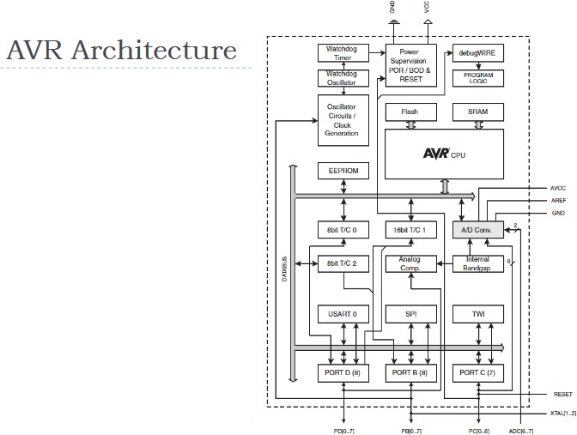

Slide 14
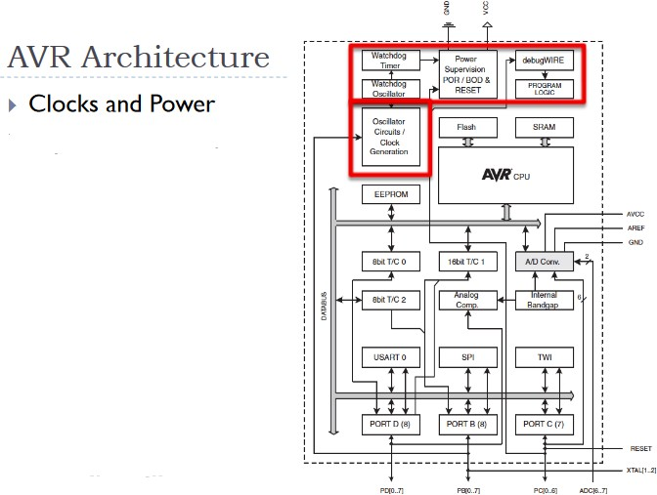

Slide 15
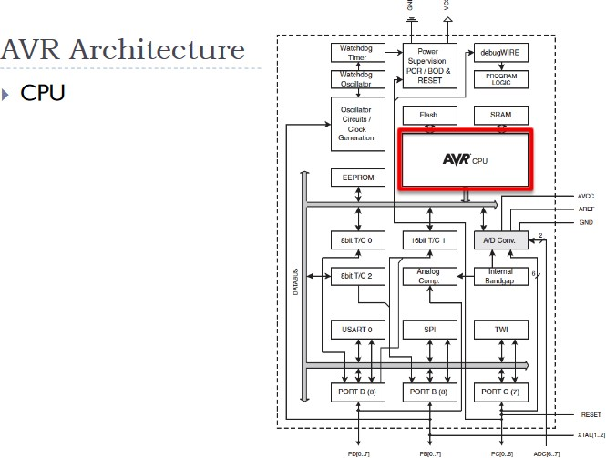

Slide 16
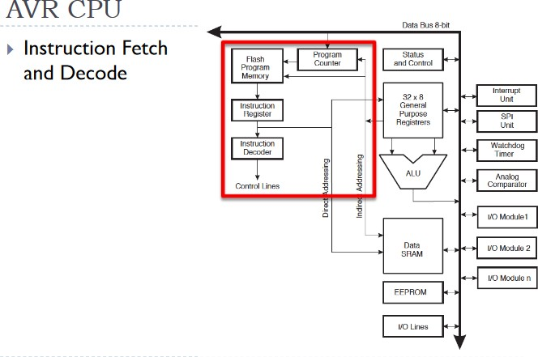

Slide 17
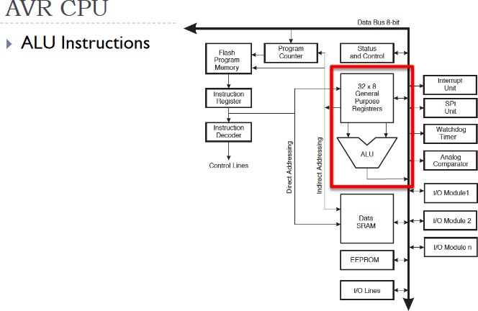

Slide 18
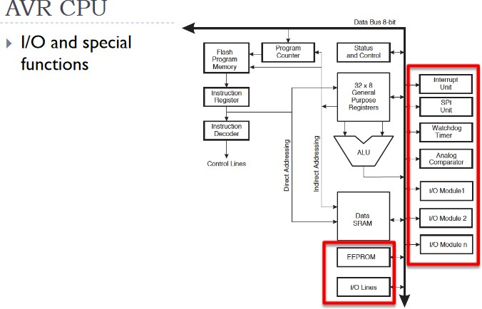

Slide 19
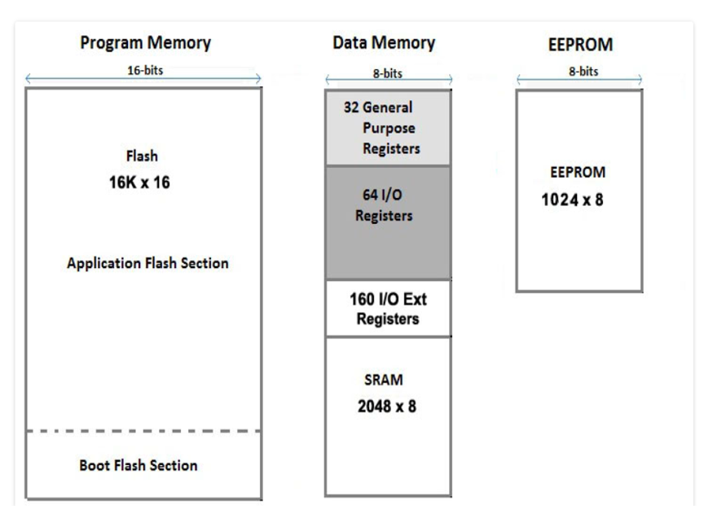
ATmega328 Memory
ATmega 328 has three types of memories:
> Flash Memory (Program Memory) has 32KB capacity. It has an address of 15 bits. It is a non volatile memory. It used for permanent saving program (CODE) being executed. The AVR executes programs stored in program memory only.
> SRAM stands for Static Random Access Memory. It is also called Data Memory. It has 2KB capacity. It is a volatile memory i.e. data will be removed after removing the power supply.
EEPROM stands for Electrically Erasable Programmable Read Only Memory. It has 1KB capacity. It has a long term data.

Slide 20
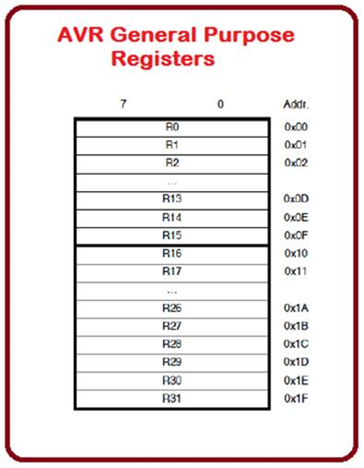
ATmega328 Registers
ATmega-328 has thirty two (32) General Purpose (GP) registers.
All these registers are the part of Static Random Access Memory (SRAM).

Slide 21
References:
ATMega328P datasheet
http://www.circuitstoday.com/arduino-uno-pinout-schematics

